Slide 1
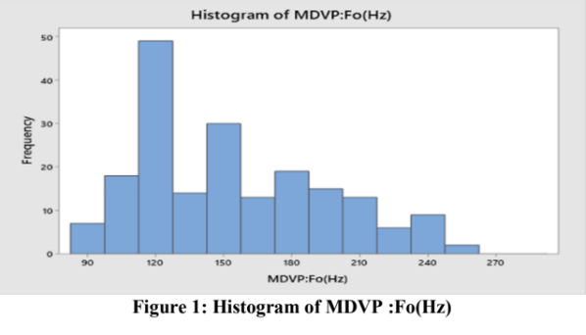
Histogram
We used histogram for analyzing all attributes of patients. We will provide the visual impression of the shape of each attribute, distribution of the measurements, information about the central tendency and scatter in the data.
Shape: The distribution of MDVP: Fo(Hz) is unimodal it has one mode at a value of 120 about which the observations are concentrated. It is right-skewed, larger values at the right tail are greater than the left tail.
Outliers: No outliers exist.
Centre: The centre of distribution approximately 165.
Spread: The data of this attribute range from 85 to 255.
The test of MDVP Fo data is mostly distributed at 120 with a frequency of 49, the 2nd is about 150 with a
frequency of 30 and the smallest frequency is at 255. The values at 135 and 165 have almost the same
frequency.

Slide 2
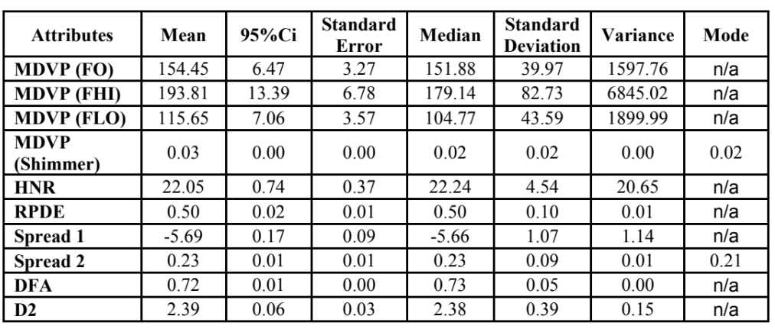
Descriptive Statistical Analysis
The goal for this section is to take a glimpse on the data as well as any irregularities so that we can correct.
Standard Deviation and Variance represent the degree of dispersion between sample values. The standard deviation and variance of MDVP: Shimmer, RPDE, Spread 2, DFA and D2 are very small which means the data are concentrated and close to the mean.
Standard Error is a measure to describe the dispersion of sampling distribution of the corresponding
sample mean and the sampling error of the corresponding sample mean. The smaller the standard error is, the more accurate the estimation of the population mean is, and the more representative the sample data is. Such as MDVP: Shimmer, RPDE, Spread 1-2, DFA and D2.
95% Confidence interval is an estimate given in interval form for an unknown parameter value in the
parameter distribution of the population generating this sample. The MDVP: Shimmer, RPDE, Spread
2, DFA and D2 demonstrate their allowable error of average value are small.
The mode of a set of data values is the value that appears most often. The mean and median are the
statistic describing the degree of data concentration to determine the equilibrium point of a set of data.

